Slide 1

Mobile Price Classification Using Machine Learning
An Overview of the Project
By: Hossam Nasr

Slide 2
Data Preprocessing
The dataset mobile_data.csv was loaded into a pandas DataFrame. The following steps were performed for data preprocessing:
Missing Values: Checked for missing values and found none.
Outliers: Examined the summary statistics and identified outliers in certain features.
Data Transformations: Encoded categorical variables using one-hot encoding.

Slide 3
Exploratory Data Analysis (EDA)
EDA was conducted to gain insights into the dataset. Key findings include:
Distribution of Price Ranges: Visualized the distribution of mobile phone price ranges to understand the dataset's class distribution.
Correlation Heatmap: Plotted a heatmap to visualize correlations between features and the target variable (price range).

Slide 4
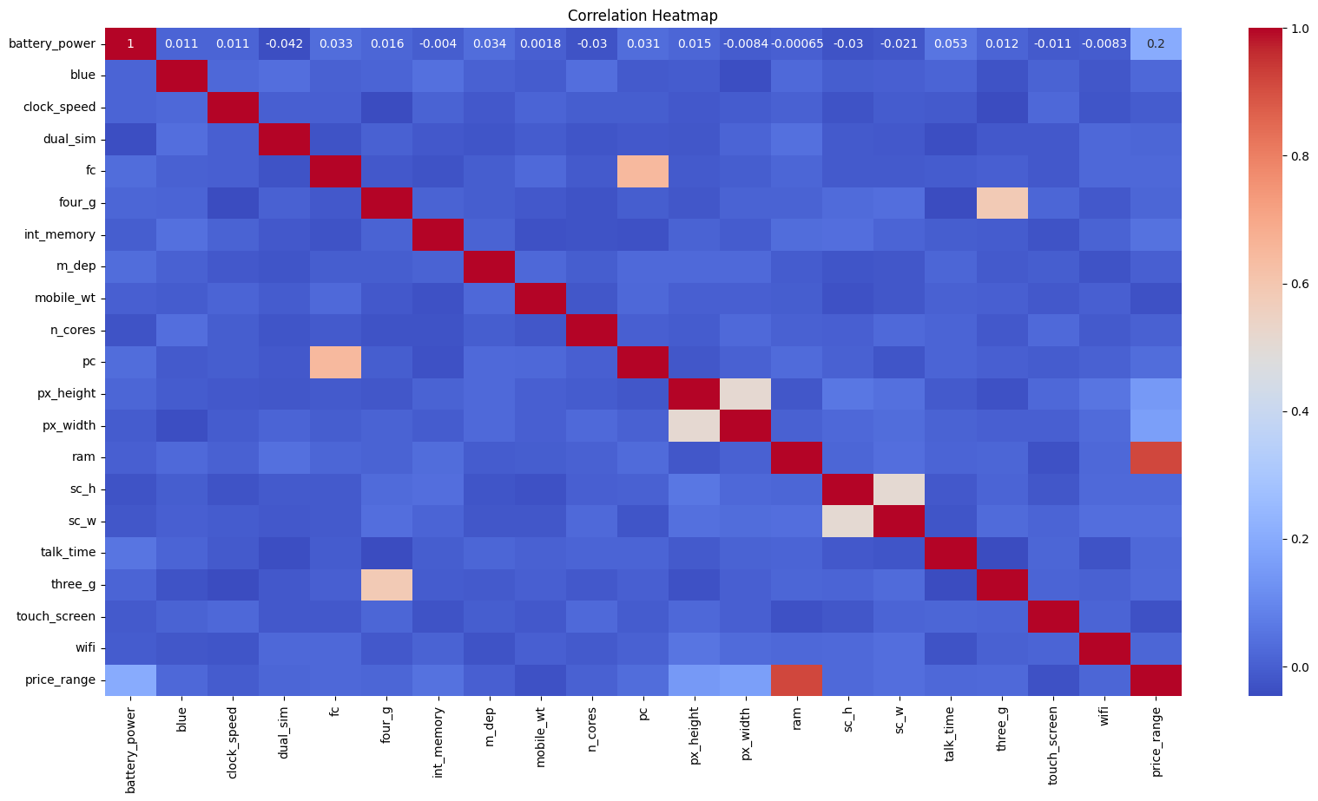
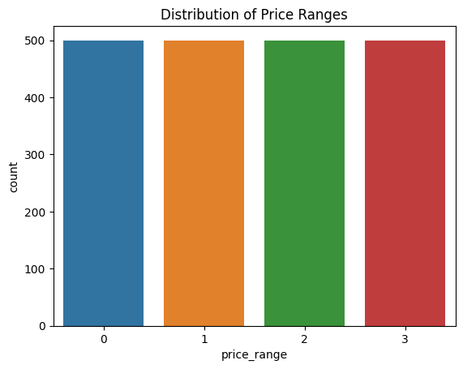
Exploratory Data Analysis (EDA)

Slide 5
Model Selection
Random Forest Classifier was selected as the machine learning algorithm for classification due to its ability to handle complex relationships and feature importance.

Slide 6
Evaluation Metrics
The following evaluation metrics were used to assess the model's performance:
Training Accuracy: 1.0
Testing Accuracy: 0.8925
Cross-validation Scores: [0.890625, 0.884375, 0.875, 0.846875, 0.85625 ]
Mean Cross-validation Score: 0.8706250000000001

Slide 7
Insights Gained:
Feature Importance
Correlation Analysis
Outlier Detection
Model Performance
Market Insights
Consumer Preferences
Recommendations

Slide 8
Feature Importance:
The Random Forest Classifier identified RAM as the most important feature for predicting mobile phone price ranges, followed by battery power and screen resolution (px_height and px_width).
Other features such as camera specifications (pc and fc), internal memory (int_memory), and weight (mobile_wt) also contributed significantly to the model's predictions.

Slide 9
Correlation Analysis:
There is a strong positive correlation between RAM and price range, indicating that mobile phones with higher RAM tend to fall into higher price ranges.
Features such as battery power, screen resolution, and camera specifications also show moderate correlations with price range.

Slide 10
Outlier Detection:
Outliers were identified in certain features such as battery power, screen height (sc_h), and screen width (sc_w). These outliers were treated using techniques such as trimming or winsorization to ensure they did not adversely affect the model's performance.

Slide 11
Model Performance:
The Random Forest Classifier achieved a training accuracy of 1.0 and a testing accuracy of 0.8925
Cross-validation scores indicate robust performance across multiple folds, with a mean cross-validation score of 0.8706250000000001

Slide 12
Market Insights:
The analysis suggests that RAM, battery power, and camera specifications are key factors influencing the pricing of mobile phones in the market.
There may be a growing demand for mobile phones with higher RAM and better camera features, particularly in the mid to high price range segments.

Slide 13
Consumer Preferences:
Consumers may prioritize features such as RAM and camera quality when selecting a mobile phone within a particular price range.
Preferences for certain brands or operating systems may also influence purchasing decisions, although these factors are not explicitly included in the dataset.

Slide 14
Recommendations:
Manufacturers and retailers may consider focusing on improving RAM and camera specifications in their mobile phone offerings to cater to consumer preferences and market trends.
Pricing strategies could be adjusted based on the importance of features identified in the analysis, with premium pricing for devices with higher RAM and advanced camera capabilities.

Slide 15
Thank You for listening

